Slide 1
PRODUCT SALES ANALYSIS

Slide 2
ABSTRACT
The "Product Sales Analysis" machine learning project aims to develop a predictive model that can analyze and forecast product sales based on historical data.
This project utilizes a dataset containing information about product attributes, sales channels, pricing, and time-related factors.

Slide 3
OBJECTIVES
Product sales analysis typically has several objectives, including:
Performance Evaluation, Identifying Trends, Customer Insights, Inventory Management, Competitive Analysis, Profitability Analysis, Marketing Effectiveness, Forecasting, Geographic Analysis, Product Lifecycle Management, Customer Retention, Identifying Growth Opportunities, Cost Reduction, Quality Improvement, Compliance and Reporting
By achieving these goals we would know about the sales, profit of the products.

Slide 4
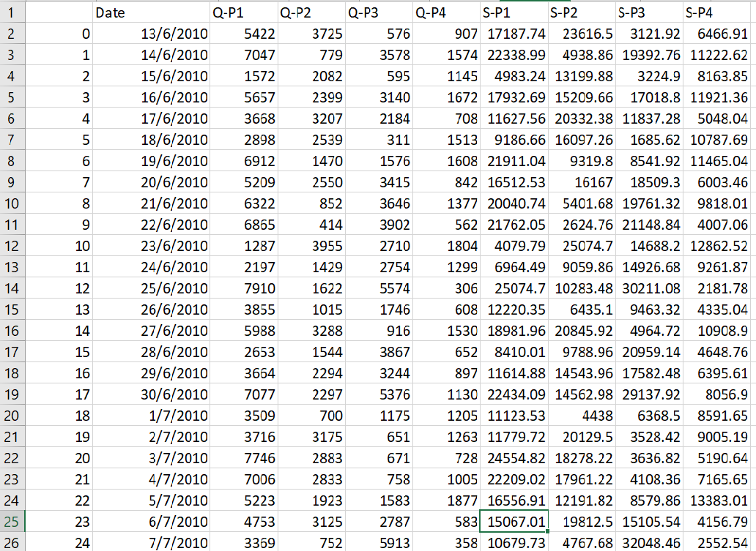
Data Source
Dataset Link:https://www.kaggle.com/datasets/ksabishek/product-sales-data

Slide 5
DESIGN THINKING
Data Preprocessing
Exploratory Data Analysis (EDA)
Feature Engineering
Predictive Modeling
Customer Segmentation
Anomaly Detection
Feature Importance Analysis
Data Visualization
Evaluation and Reporting
Business Recommendations

Slide 6
DATA PREPROCESSING
Clean the dataset: Check for missing values and outliers.
Convert the 'Date' column to a datetime format for time series analysis.
Create new features if needed, such as total sales, profit, or seasonality indicators.
Exploratory Data Analysis (EDA)
Visualize the data to understand the trends, seasonality, and correlations.
Calculate basic statistics and metrics to gain insights into the dataset.

Slide 7
Feature Engineering
Create relevant features that could help predict sales, such as day of the week, month, or any external factors like holidays.
Predictive Modeling:
Split the dataset into training and testing sets.
Apply various machine learning models for predicting future sales, such as linear regression, decision trees, random forests, or time series models like ARIMA or Prophet.
Tune the hyperparameters of the models to achieve the best accuracy.

Slide 8
Customer Segmentation:
Utilize clustering algorithms (e.g., K-means) to segment customers based on their purchasing behavior.
Anomaly Detection:
Implement anomaly detection techniques, such as Isolation Forest or One-Class SVM, to identify irregular sales patterns or deviations.

Slide 9
Feature Importance Analysis:
Evaluate the importance of each feature in predicting product sales. This can help in understanding which factors have the most significant impact.
Data Visualization:
Create visualizations to represent the results of your analysis. This can include sales forecasts, customer segments, and anomaly alerts.

Slide 10
Evaluation and Reporting:
Evaluate the performance of the machine learning models using appropriate metrics (e.g., RMSE for regression models).
Generate reports or dashboards to present the results and insights to stakeholders.
Provide actionable recommendations based on the analysis. For example, suggestions for inventory management, pricing strategies, or targeted marketing campaigns.
Business Recommendations:

Slide 11
CONCLUSION
The project aims to help businesses optimize their operations, maximize sales, and improve customer satisfaction. It provides a comprehensive solution for analyzing historical sales data and leveraging machine learning techniques to make informed business decisions.
Please note that this is a high-level overview, and the specific implementation details and choice of machine learning models may vary based on the characteristics of your dataset and the goals of your analysis.

Slide 12
THANK
YOU

